Slide 1
Computational Bioinformatics Research Project
Instructor : Dr. Al- Mubaid Hisham
Presented by
Tejaswi Bharadwaj Pullabhotla
Jayesh Pashilkar
Sanif Maredia
Sai Krishna Kotha
Nitin Gottiparthi

Slide 2
Introduction
In this research work, we classify the given set of gene into its respective disease class based on machine learning techniques such as Naïve Bayes and Weighted Probability.

Slide 3
Data Set Information
Genes
- Number of Genes: 400 HIV, 400 TB
- Type of Gram implemented: 3 gram
Gene Database Specifications:
- Original gene database
- No of rows: 800
- No of columns: 64
- No of rows: 30
- No of columns: 11

Slide 4
Gene Dataset and Matrix Designing:
We have developed 3 programs for building Gene dataset and gene matrix. The programs are as follows:
ACCTGGTGTGGGTGTGCAACATGCATGTGG
ACC, TGG, TGT, GGG,TGT,GCA,ACA,TGC,ATG,TGG
AAA | ACG | ACT
1 | 0 | 1
0 | 1 | 1

Slide 5
Steps Implemented
Gene Sequence Collection
Matrix Building
Matrix Comparison
Application of Bayesian, Naïve Bayes on dataset

Slide 6
Bayesian
Bayesian Learning & Probability:
Bayes Probability is the basis for efficiency computing unknown conditional probabilities which is as follows:
Using Bayes rule we can measure the probability of hypothesis h (disease) given the evidence of the training set D (gene) : P(h|D) = P(D|h).P(h)
P(D)

Slide 7
Naïve Bayes Classifier:
In machine learning, naive Bayes classifiers are a family of simple probabilistic classifiers based on applying Bayes' theorem with strong (naive) independence assumptions between the features

Slide 8
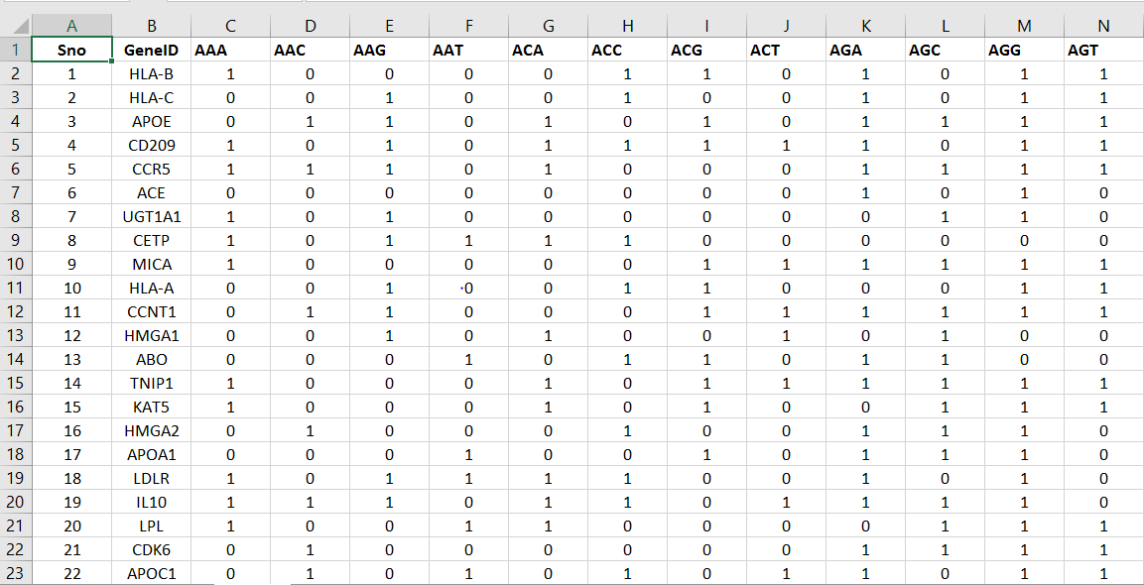
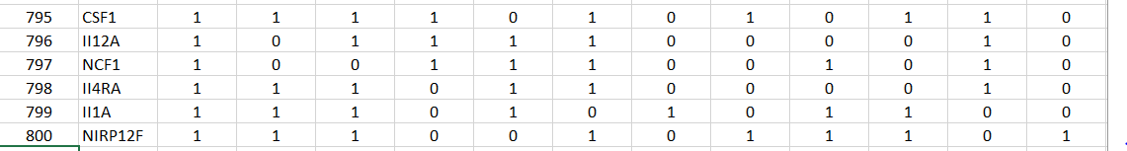
Original Dataset

Slide 9
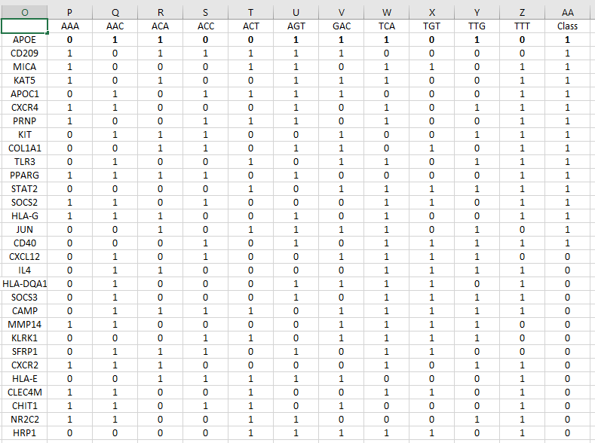
Reduced Dataset

Slide 10
Result for Bayesian Classification and Weighted Probability
Bayesian Classification
Number of genes that are classified accurately = 13
Total records = 30
Percentage (%) of Accuracy = (13/30) *100 = 43.33%
Weighted Probability
Number of Genes that are classified correctly=19
Total Number of Genes=30
Percentage of Accuracy=(19|30)*100
=63.33

Slide 11
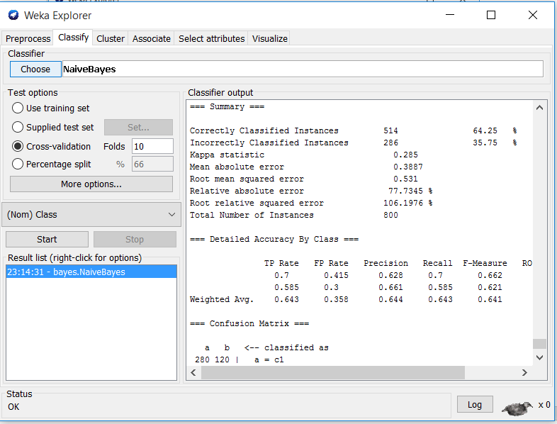
Results for Naïve Bayes classification on WEKA tool

Slide 12
Thank you… Any Queries???

